Slide 1
More about Extensions and Lambdas
2019
Notes:
1

Slide 2
Extension scopes
Top Level - accessible from anywhere
in util.kt file
internal fun Int.hoursInMillis() = TimeUnit.HOURS.toMillis(this)
decompiled java
public final class UtilKt {
public static final long hoursInMillis(long $receiver) {
return TimeUnit.HOURS.toMillis($receiver);
}
}

Slide 3
Extension scopes
Member - accessible from class
class Calculator {
fun calculate(number: Int) = number.hoursInMillis() * getSomething()
private fun Int.hoursInMillis() = TimeUnit.HOURS.toMillis(this)
}
decompiled java
public final class Calculator {
public final long calculate(int number) {
return this.hoursInMillis(number) * getSomething();
}
private final long hoursInMillis(int $receiver) {
return TimeUnit.HOURS.toMillis((long)$receiver);
}
}

Slide 4
Extension scopes
Local - accessible from function
class Calculator {
fun calculate(number: Int) = number.hoursInMillis() * getSomething()
private fun Int.hoursInMillis() = TimeUnit.HOURS.toMillis(this)
}

Slide 5
Extension scopes
Context - accessible from class implementing context interface
interface LockScope { val lock: Lock }
fun <R> LockScope.lock(timeout: Long, block: () -> R): R {
if (lock.tryLock(timeout, TimeUnit.SECONDS)) {
try { return block() } finally { lock.unlock() }
}
throw TimeoutException()
}
class Service : LockScope {
override val lock = ReentrantLock()
fun execute() {
lock(timeout = 5) { ... }
}
}

Slide 6
Inlining
inline fun <T, R> Iterable<T>.map(transform: (T) -> R): List<R>
// kotlin
listOf(1,2).map { it + it }
// decompiled java
Iterable receiver = CollectionsKt.listOf(new Integer[]{1, 2}); Collection destination = new ArrayList(...); Iterator iterator = receiver.iterator(); while(iterator.hasNext()) { Object item = iterator.next(); int it = ((Number)item).intValue(); destination.add(it + it); }

Slide 7
Inlining
inline fun CharSequence.replace(
regex: Regex,
noinline transform: (MatchResult) -> CharSequence): String {
// passing to a normal function
return regex.replace(this, transform)
}
we can inline functions with lambda parameters only if
- the lambda is either called directly
- or passed to another inline function

Slide 8
Inlining
class Controller {
fun blockUser(request: Request): Int {
if (!request.hasAccess()) {
println("No access")
return -1
}
...
}
fun deleteUser(request: Request): Int {
if (!request.hasAccess()) {
println("No access")
return -1
}
...
}
}

Slide 9
Inlining
class Controller {
private fun checkAcess(request: Request): Int {
if (!request.hasAccess()) {
println("No access")
return -1
}
return 0
}
fun blockUser(request: Request): Int {
checkAcess(request)
...
}
fun deleteUser(request: Request): Int {
checkAcess(request)
...
}
}

Slide 10
Inlining
class Controller {
private fun checkAcess(request: Request): Int {
if (!request.hasAccess()) {
println("No access")
return -1
}
return 0
}
fun blockUser(request: Request): Int {
if (checkAcess(request) == -1) return -1
...
}
fun deleteUser(request: Request): Int {
if (checkAcess(request) == -1) return -1
...
}
}

Slide 11
Inlining
class Controller {
private inline fun withAccess(request: Request, action: () -> Int): Int {
if (!request.hasAccess()) {
println("No access")
return -1
}
return action()
}
fun blockUser(request: Request) = withAccess(request) {
...
return 0
}
fun deleteUser(request: Request) = withAccess(request) {
...
return 0
}
}

Slide 12
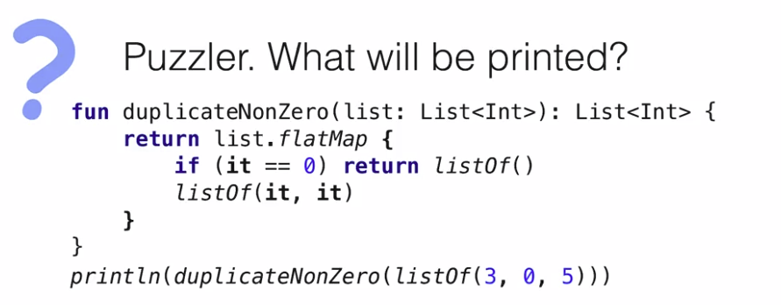
1. [ [3, 3], [ ], [5, 5] ]
2. [3, 3, 5, 5]
3. [ ]

Slide 13
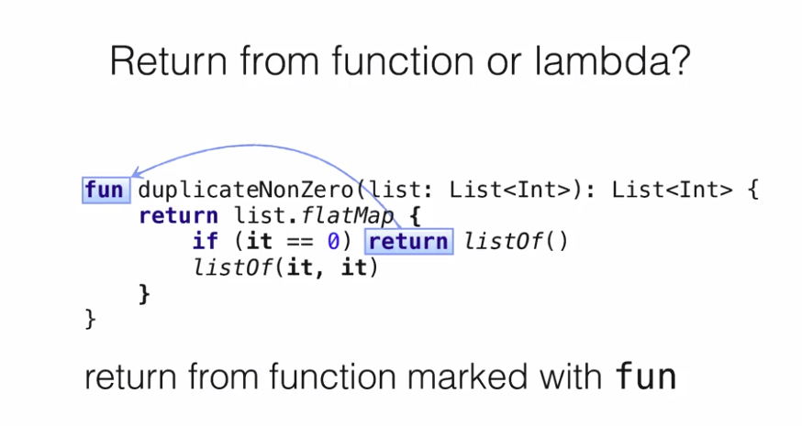

Slide 14
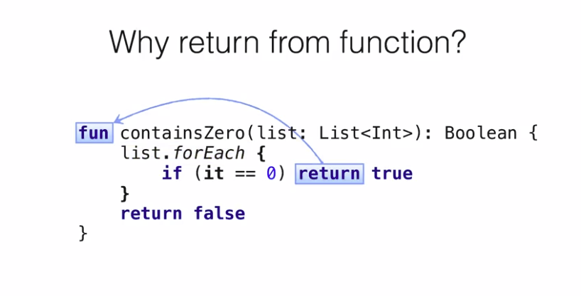

Slide 15
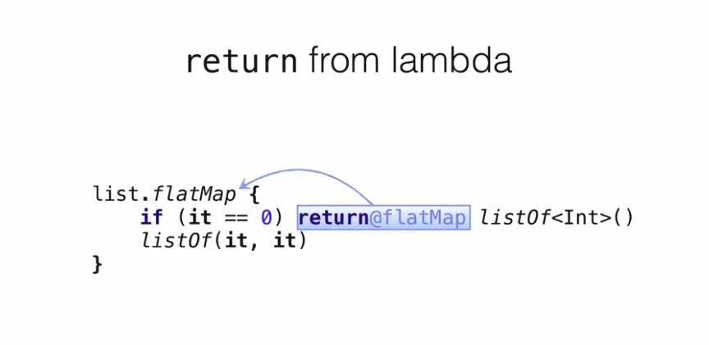

Slide 16
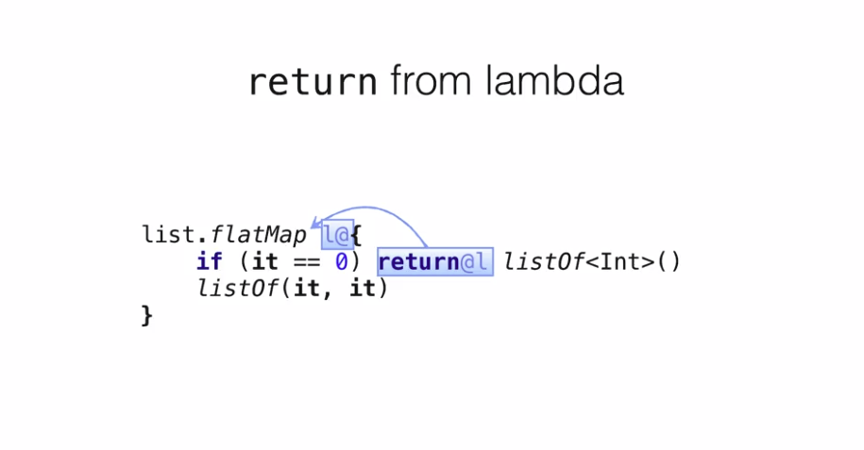

Slide 17
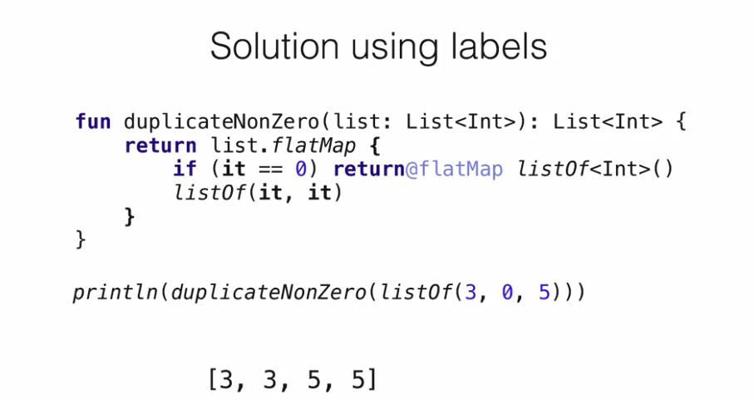

Slide 18
